Slide 1


Green Pace
Security Policy Presentation
Developer: Ryan Stork

Slide 2

OVERVIEW: DEFENSE IN DEPTH
The security policy that I am recommending to implement is a viable, cost effective Defense-in-Depth strategy. This will lower the chances of a successful attack, mitigate losses in a potential attack and protect the company from lawsuits, should an issue arise.

Slide 3
THREATS MATRIX
Likely Hacker gaining access thru non-secure code | Priority Prevent DoS attacks
Low priority Brute force attack to gain entrance to our data | Unlikely Hacker gaining entrance to facility
Notes:
These are some of the security risks that have been found and prioritized in the threat matrix. Using a static testing tool like CPPCheck or Maven can help assess previously found
Vulnerabilities to make sure they are protected against and mitigated. The most likely method of a hacker gaining access to our system would be thru insecure code. This is the purpose of the static testing tool. We will also use the defense in depth strategy to prevent Denial of Service attacks, which is a priority. Our policy of limiting the number of invalid usernames and passwords will help prevent a brute force attack, so that is a low priority. We will also have a secure entrance with cameras, so that a hacker gaining entrance is a very unlikely possibility.

Slide 4
10 PRINCIPLES
Validate User Input - [INT-33-C] [STR -50-CPP] [STR-02-C]
Heed Compiler Warnings - [STR -50-CPP]
Architect and Design for Security Policies - [STR -50-CPP] [STR-02-C] [MEM-51-CPP] [DCL-03-C] [ERR-57-CPP]
Keep it Simple - [DCL-53-CPP] [EXP-50-CPP]
Default Deny
Adhere to the principle of least privilege
Sanitize data sent to other systems - [STR-02-C] [MSC-11-C]
Practice defense in depth
Use effective Quality Assurance Techniques - [DCL-03-C] [ERR-50-CPP]
Adopt a secure coding standard - [MEM-51-CPP] [MSC-11-C] [ERR-57-CPP]
Notes:
These 10 principles are found in every coding standard for each programming language, written in white. Along with them are 10 secure coding standards, written in orange showing the connection between the two.

Slide 5
CODING STANDARDS
I have chosen 10 coding standards to protect against as we create secure code. The standard that I rank these is a multiplication between the Severity of the event occurring and its likelihood. The more severe and likely, the higher the score.
[STR -50-CPP] - Guarantee that storage space for strings has sufficient space for character data and the null terminator. High and likely.
[STR-02-C] - Sanitize data passed to complex subsystems. High and Likely
[MEM-51-CPP] - Properly deallocate dynamically allocated resources. High and likely.
[EXP-50-CPP] - Do not depend on the order of evaluation for side effects. Medium and Probable
[INT-33-C] - Ensure that division and remainder operations do not result in a divide-by-zero errors. Low and Likely.
[ERR-57-CPP] - Do not leak resources when handling exceptions. Low and Probable.
[ERR-50-CPP] - Do not abruptly terminate the program. Low and Probable.
[MSC-11-C] - Incorporate diagnostic tests using assertions. Low and Unlikely.
[DCL-03-C] - Use the static assertion test to test the value of a constant expression. Low and Unlikely.
[DCL-53-CPP] - Do not write syntactically ambiguous declarations. Low and Unlikely

Slide 6
ENCRYPTION POLICIES
Encryption in rest:
Data that is not moving between systems is said to be at Rest. This can be data in a database like a user’s name and address. It may not ever get updated and stay at rest in the system. Sensitive information like this should be encrypted to keep prying eyes away from private data.
Encryption at flight:
Data in flight would be in transit from a database or program to the user. This needs to be encrypted to make sure there is no man-in-the-middle attack, where a malicious user tries to steal data in transit.
Encryption in use:
Data that is currently being used should be encrypted if there is a way that a malicious user can gain access to it. Data in use is data that has arrived at the user’s UI. We need to make sure that our data can be seen by the user, but someone can not easily take the information behind the scenes.

Slide 7
TRIPLE-A POLICIES
Authentication:
Authentication is proving a user’s identity. This is done in multiple ways. We can prove something we know, something we are, or something we have. Something we know is a password to a system. Something we are is a fingerprint or some other form of authentication. Something we have is a secondary device like Google Authenticator which has revolving numbers to prove identity.
Authorization:
Authorization is giving people proper access to do their jobs. For the process of least privilege, we need to determine the user level of access. This will make sure that they cannot get into programs that they have no need to be in.
Accounting:
Accounting refers to the record keeping of users for authentication and authorization. If a team member leaves the company, they should have their authentication revoked. This should be done with changes to the database. The same would happen with the addition of new users or if a user’s scope changes.

Slide 8
Unit Testing
The vulnerability that I am testing is with vectors.

Slide 9
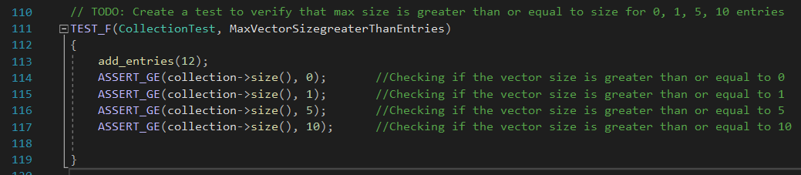
Unit Testing Vector Max Size

Slide 10
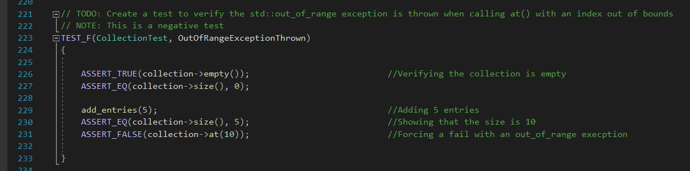
Unit Testing Vector Out of Bounds

Slide 11
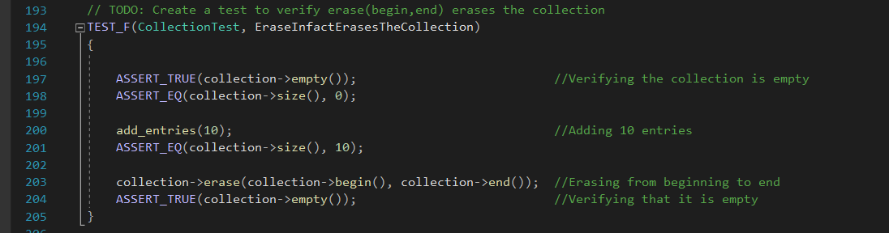
Unit Testing Erase the Collection

Slide 12
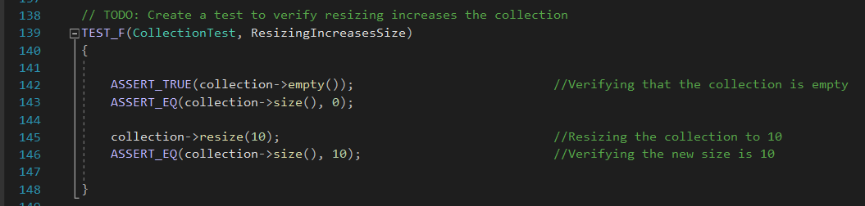
Unit Test Vector Resizing

Slide 13
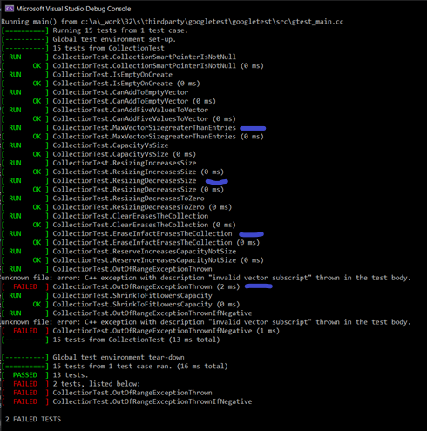
Unit Testing - Results
This is a picture of the results from the Unit Testing. The ones marked in blue are the results of running the tests. All the ones that were supposed to pass, did pass. The ones that were supposed to fail, did fail.

Slide 14

AUTOMATION SUMMARY

Slide 15
TOOLS
With automation, we will assess the situation and develop a plan. We will then design a plan to make sure that all the security measures that were planned for are tested for. We will create a secure build that will encompass our design. We will then verify and test the product. Once a successful secure build is made, we will transition to a production role and provide health checks of the software. We will have software that can monitor and detect when an issue occurs. We will respond with a software update and patch. Finally, we will maintain and stabilize any issue of destabilization.

Slide 16
RISKS AND BENEFITS
There will always be more problems if you wait to solve to solve an issue once it is found. The cost will also be greater. If a problem is found, but not solved, then it may occur again. If it occurs when the product has been launched, it requires reprogramming and redeployment back into the field. There might also be monetary compensation because of the cause of failure.
Instead, you should act now. This lowers the overall risk, and it is the cheapest to fix a problem immediately vs later. If a developer doesn’t correct the situation, then the problem should be given to the project manager. This person will make sure that the issue is resolved.

Slide 17
RECOMMENDATIONS
The gaps in this security policy lie with making sure that the system stays up to date and with the trends of hacking
If a patch comes out for the system, we should update to the most current patch. This will close any vulnerabilities that may have been found and fixed.
If a trend of a certain type of attack becomes prevalent, like Denial-of-Service attacks, we should make sure that the system is protected against such attacks.

Slide 18
CONCLUSIONS
The number one standard that should be adopted into this program is developing secure code from the beginning.
This is a team project; we should be working as a team to make sure that the programs are secure.
Code should be written by one person and reviewed by a different person to reduce the chance of cognitive dissonance.

Slide 19
REFERENCES
Seacord, R. C. (20130323). Secure Coding in C and C, 2nd Edition. [[VitalSource Bookshelf version]]. Retrieved from vbk://9780132981972
Admin, 5/29/2020. SEI Cert C++ Coding Standard. Retrieved from: https://wiki.sei.cmu.edu/confluence/pages/viewpage.action?pageId=88046682

